Slide 1
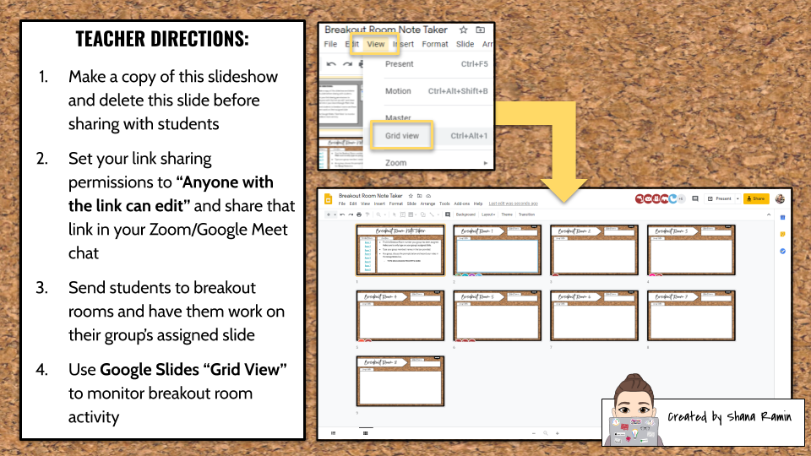
Blog | YouTube | Instagram | Twitter

Slide 2
Room 1
Room 2
Room 3
Room 4
Room 5
Room 6
Room 7
Room 8
Find the Breakout Room number your group has been assigned. Make sure to only type on your group’s assigned slide.
Type your group members’ names in the box provided.
As a group, discuss the prompts below and record your notes in the Group Notes box.
  TYPE DISCUSSION PROMPTS HERE

Slide 3
DIRECTIONS

Slide 4
DIRECTIONS

Slide 5
DIRECTIONS

Slide 6
DIRECTIONS

Slide 7
DIRECTIONS

Slide 8
DIRECTIONS

Slide 9
DIRECTIONS

Slide 10
DIRECTIONS

